Slide 1
What is DOM ?
DOM stands for Document Object Model

Slide 2
The Document Object Model (DOM) is a programming interface for HTML and XML documents. It provides a structured representation of the document and it defines a way that the structure can be accessed from programs so that they can change the document structure, style and content. The DOM provides a representation of the document as a structured group of nodes and objects that have properties and methods. Essentially, it connects web pages to scripts or programming languages.
A Web page is a document. This document can be either displayed in the browser window, or as the HTML source. But it is the same document in both cases. The Document Object Model (DOM) provides another way to represent, store and manipulate that same document. The DOM is a fully object-oriented representation of the web page, and it can be modified with a scripting language such as JavaScript.

Slide 3
<!DOCTYPE html>
<html>
<head>
<title>Learning DOM</title>
</head>
<body>
<h1>DOM</h1>
<div>
<ul>
<li>HELLO</li>
<li>DOM</li>
</ul>
</div>
</body>
</html>
html
head
body
title
h1
div
ul
Nodes
li
li
DOM Tree

Slide 4
DOM API Reference
https://developer.mozilla.org/en-US/docs/Web/API
https://developer.mozilla.org/en-US/docs/Web/API/Document_Object_Model

Slide 5


Slide 6
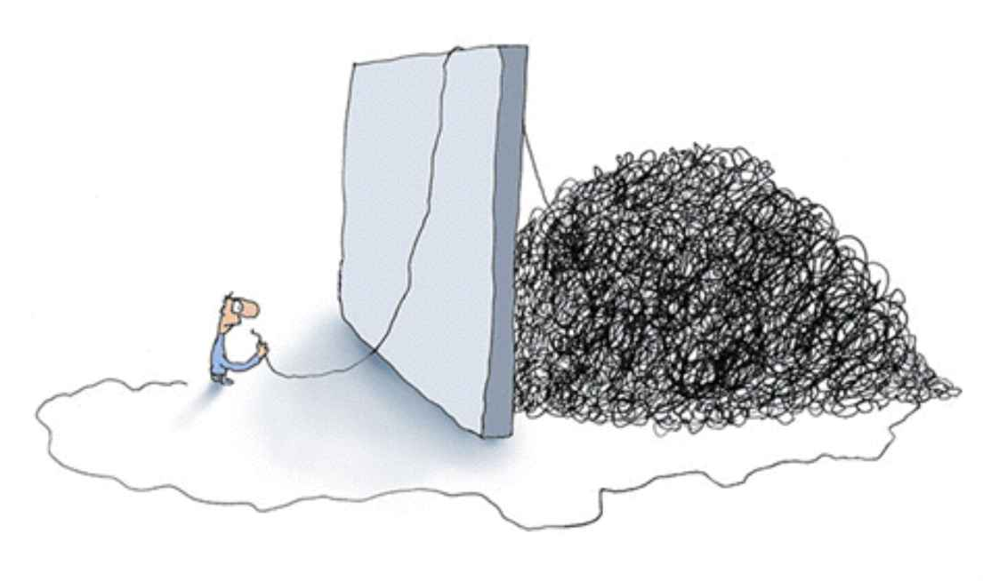
What is jQuery ?
jQuery is a JavaScript Framework which helps to manipulate the DOM easily .
So when dealing with the DOM, don't try to seperate jQuery as something you inject externaly. Instead, try to see it as a something that has attached with the DOM already.
So, if you use DOM, you do it through the jQuery.
Since jQuery, This is how we see DOM
jQuery
Real DOM

Slide 7
It is time to download :-)
http://jquery.com/

Slide 8

jQuery is all about
RS
But if you want, you can change it to
:)

Slide 9
Basic jQuery Usage
.
Then do whatever you want to do with it
( '#div1>ul>li' )
It is identical to how we use selectors to select elements in CSS

Slide 10
jQuery Documentation
http://api.jquery.com/

Slide 11
4 - "Most Used" jQuery Functions
text ( [ value ] )
html ( [ value ] )
css ( property, [ value ] )
attr (attribute, [ value ] )

Slide 12
Forms and jQuery
val ( [ value ] )
submit ()

Slide 13
Traversing & Manipulation
"Commonly Used" Traversing & Manipulation Functions
Traversing
Manipulation
append
prepend
clone
remove
replaceWith
children| find
parent | parents
first
last

Slide 14
Events
Global Events
https://developer.mozilla.org/en-US/docs/Web/API/GlobalEventHandlers
Specified Events
Event Name
Usage :-
$ ( " btnLogin " ) . on ( " click " , function_name ) ;
Remeber, this function has "Event Data" parameter

Slide 15
More about Events - I
We can attach multiple functions to handle a single event.
$ ( " btnLogin " ) . on ( " click " , function_1 ) ;
$ ( " btnLogin " ) . on ( " click " , function_2 ) ;
We can also deattach functions from an event.
$ ( " btnLogin " ) . off ( " click " ) ;
$ ( " btnLogin " ) . off ( " click ", function_1 ) ;

Slide 16
More about Events - II
jQuery has formalized some frequently used events for ease in use.
click(function)
dblclick(function)
foucs(function)
blur(function)
keydown(function)
keyup(function)
keypress(function)
mousedown(function)
mouseup(function)
mousemove(function)

Slide 17
$(document).ready (function)
or
$(function)
vs
$(window).on ('load', function)

Slide 18

Download
http://jqueryui.com/
Documentation
http://api.jqueryui.com/

Slide 19
jQuery Plugins Repository
https://plugins.jquery.com/

Slide 20
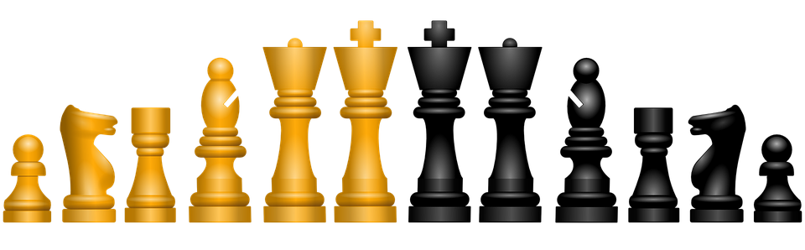
Assignment*
*
You can't use any sort of chess related 3-rd party libaries like chessboard.js

